Slide 1

NLP POWERED
AI Text Analysis
Platform
Professional NLP Dashboard for Topic Modeling & Sentiment Analysis
Real-time Analytics
ML Powered
Web Interface

Slide 2
Navigation
Overview
01
Project Overview
05
Training & Evaluation
AI-driven text analytics system objectives and outcomes
Model training process and performance metrics
02
Dataset & Key Insights
06
Results & Impact
Data composition and analytical findings
Successful outcomes and performance achievements
03
Data Processing Pipeline
07
User Interface
EDA, preprocessing, and feature extraction
Interactive web application showcase
04
Model Architecture
08
Conclusion
System design and component integration
Summary and key takeaways

Slide 3
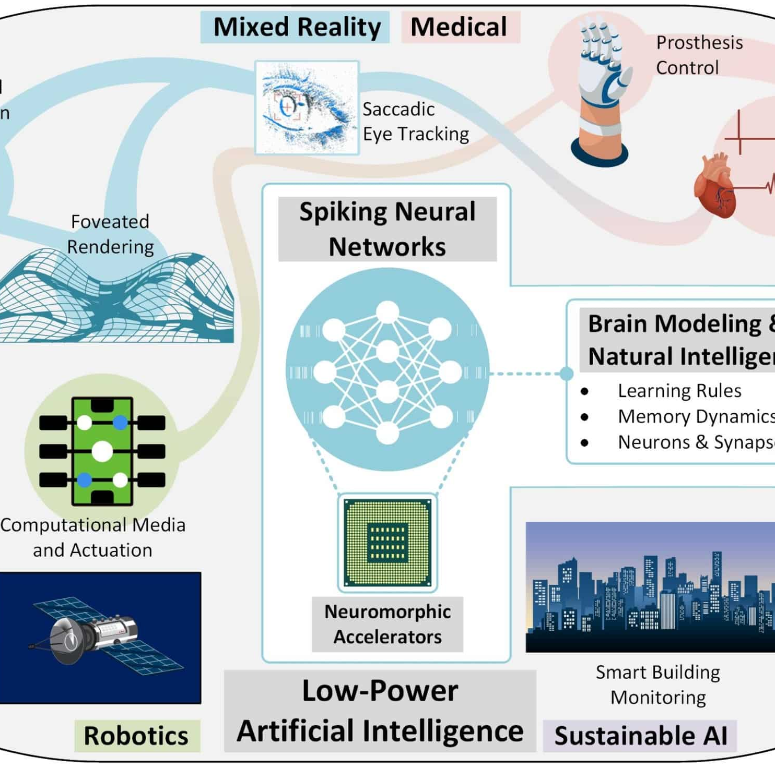
Introduction
Project Overview
Objective
Design and deploy an AI-driven text analytics system that automatically processes unstructured textual data by performing cleaning, feature extraction, topic modeling, and sentiment analysis. The system delivers actionable insights through an interactive web application, enabling efficient interpretation and decision-making from large volumes of text data.
Key Outcomes
1
Automated Extraction
Topics and sentiments from unstructured text using ML techniques
2
Interactive Web App
Real-time text analysis and visualization of insights
3
Improved Performance
Enhanced accuracy, efficiency, and scalability in processing
NLP
NMF
ML
Processing
Topic Model
Classification

Slide 4
Data Foundation
Dataset Overview & Key Insights
Dataset Overview
Key Insights
The dataset consists of unstructured textual data collected from user-generated sources such as reviews, comments, or documents. Each record contains raw text that undergoes comprehensive processing.
1
Dominant Topics
Identified across dataset, revealing recurring themes and user focus areas
Raw text from multiple sources
2
Sentiment Distribution
Highlights overall public opinion trends across positive, negative, and neutral responses
Cleaning and tokenization pipeline
TF-IDF vectorization preparation
3
Preprocessing Impact
Ready for topic modeling & sentiment analysis
Significantly improves model performance by reducing noise and redundancy
Reviews
Comments
Documents

Slide 5
Analysis Phase
Exploratory Data Analysis
Data Profiling
Word Frequency Analysis
Theme Patterns
Analyzed data volume and text length distribution
Examined word frequency and TF-IDF scores to highlight dominant terms influencing topic formation.
Observed recurring themes and patterns that guided topic modeling using NMF algorithm.
Examined vocabulary size and diversity metrics
Identified data quality issues and patterns
High
Key
Topic Clustering
TF-IDF Terms
Indicators
Identified natural groupings in text data
Pattern Recognition
Noise Removal
Discovered semantic relationships
Sentiment Distribution
URLs
Special Characters
Stopwords
NMF Guidance
Redundant Terms
Evaluated sentiment class distribution to detect opinion trends across the dataset.
Informed model parameter selection
+
−
=
Positive
Negative
Neutral

Slide 6
Processing Pipeline
Data Preprocessing
Raw Text Input
Clean Text Output
1
Noise Removal
2
Normalization
3
Tokenization
4
Stopword Removal
5
Lemmatization
URLs
Lowercase Conversion
Text Splitting
Common Words
Base Form
Email Addresses
Whitespace Elimination
Word Tokenization
Noise Reduction
Word Reduction
Hashtags
Text Consistency
Sentence Splitting
Data Cleaning
Performance ↑
Special Characters
Standardization
Token Stream
Dimensionality ↓
Quality Boost
Punctuation
Comprehensive Pipeline
Model Ready Output

Slide 7
Feature Engineering
Feature Extraction with TF-IDF
TF-IDF Vectorization
How It Works
Transforms preprocessed text into numerical representations using Term Frequency-Inverse Document Frequency (TF-IDF) vectorization technique.
1
Term Frequency Calculation
Measures how frequently a term appears in a document
2
Inverse Document Frequency
TF-IDF Formula
Reduces weight of common terms across all documents
3
Feature Matrix Generation
TF-IDF = TF × IDF
Creates numerical input for ML models
TF
IDF
Term Frequency
Inverse Doc Freq
Key Benefits
Word Importance
Noise Reduction
Keyword Focus
Feature Matrix

Slide 8
System Design
Model Architecture
End-to-End Pipeline Architecture
NMF Model
Topic Modeling
Raw Text
Preprocessing
TF-IDF
Reviews
Cleaning
Vectorization
Comments
Tokenization
Feature Matrix
Documents
Lemmatization
Numerical Data
Sentiment
Classification
Backend Processing
Web Application
Visualization

Slide 9
Model Development
Training & Evaluation
Training Process
Evaluation Metrics
1
TF-IDF Conversion
Topic Coherence
Preprocessed text converted to numerical features using TF-IDF vectorizer
Analyzes quality and interpretability of NMF-generated topics
2
NMF Model Training
Accuracy
Precision
Trained on TF-IDF matrix to learn latent topics and extract keywords
Overall correctness
True positive rate
Recall
F1-Score
3
Sentiment Classifier
Trained using labeled data to identify positive, negative, and neutral sentiments
Sensitivity measure
Harmonic mean
Validation
Model outputs validated through qualitative inspection of topics and sentiment predictions on sample texts.

Slide 10
Outcomes
Results & Performance
Topic Extraction
Sentiment Analysis
Visualization
Meaningful Topics
Accurate Classification
Integrated Dashboard
Successfully extracted coherent topics from unstructured text using NMF model
Precisely classified text into positive, negative, and neutral categories
Web application with seamless visualization integration
Representative Keywords
Opinion Trends
Clear Interpretation
Identified key terms that accurately represent each topic cluster
Reflected overall sentiment distribution across the dataset
Intuitive visual representation of topics and sentiment distributions
Theme Organization
Balanced Performance
Interactive Features
Clear thematic structure with well-defined topic boundaries
Consistent accuracy across all sentiment classes
Real-time analysis with dynamic visual updates
Successful Implementation
Production Ready

Slide 11
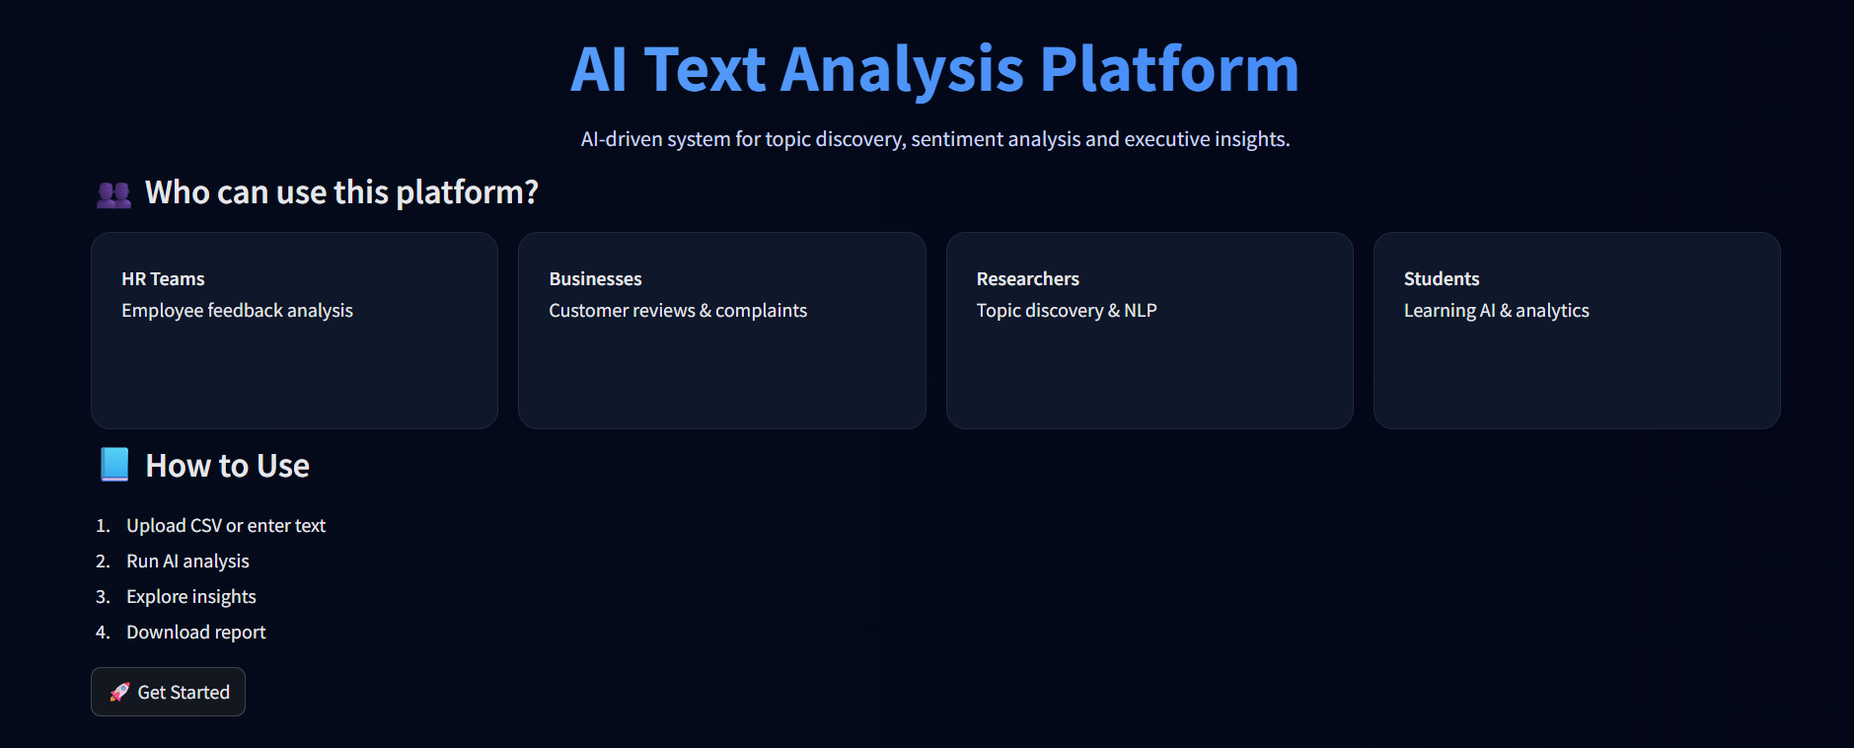
Application
User Interface
Interactive Web Application
A modern, intuitive web interface that enables users to perform real-time text analysis with seamless visualization of topics and sentiment distributions.
Real-time Analysis
Visual Dashboard
Instant processing and results display
Interactive charts and graphs
Topic Display
Sentiment View
Clear topic visualization with keywords
Color-coded sentiment indicators
Key Features
Text Input
Batch Processing
Export Results
History Tracking
100%
<1s
Responsive Design
Responsive
Response Time

Slide 12

PROJECT COMPLETE
Conclusion
Successfully delivered an end-to-end AI text analytics solution
End-to-End System
Meaningful Insights
Developed a comprehensive AI-based text analytics system integrating preprocessing, topic modeling, and sentiment analysis in a unified pipeline.
Successfully extracted actionable topics and sentiment insights from unstructured text data, enabling data-driven decision making.
Interactive Platform
ML Effectiveness
Implemented an intuitive web application for real-time analysis and visualization, making complex NLP accessible to users.
Demonstrated the power of machine learning techniques in automating large-scale text analysis with high accuracy and efficiency.
AI-Powered Text Analytics

